Slide 1
Water conservation
Saving our most valuable resource

Slide 2
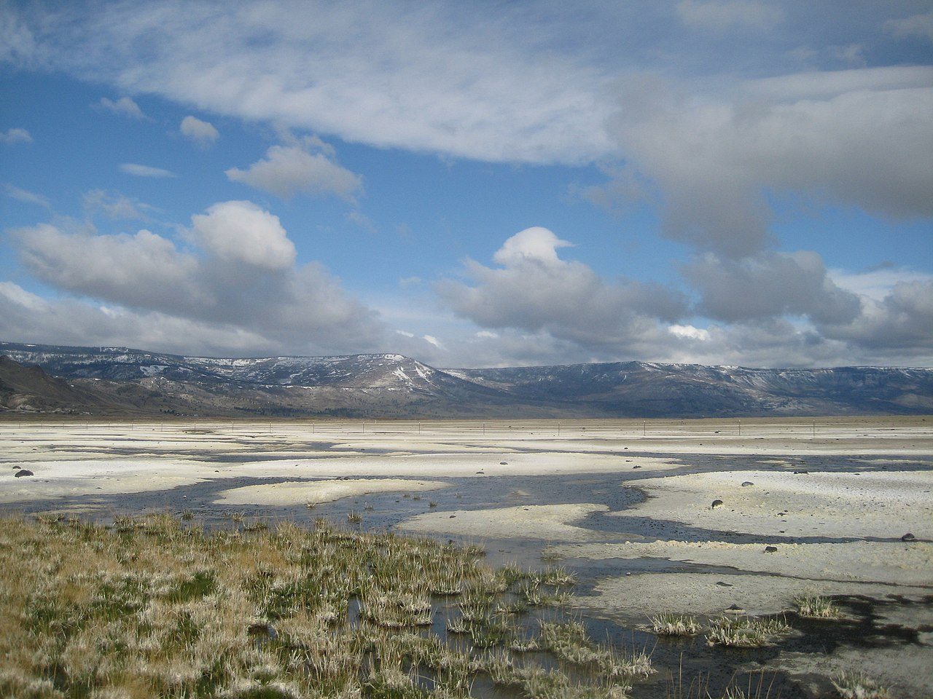
What is water conservation?
The practice of using water more efficiently to help preserve and control development of both surface and groundwater resources

Slide 3
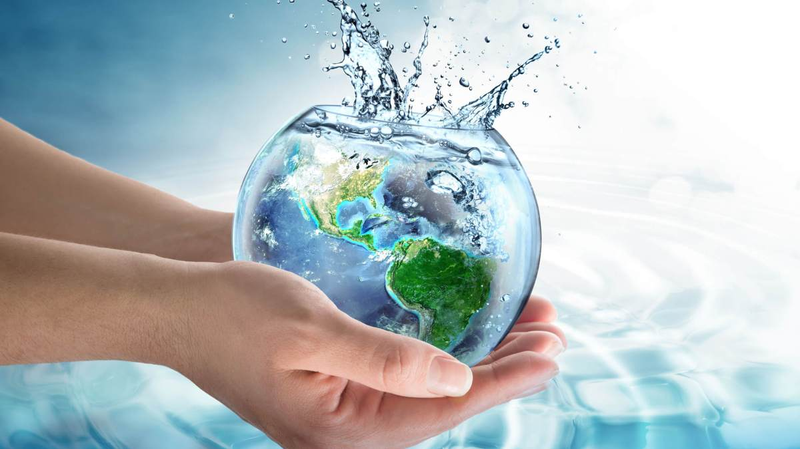
Why water conservation is important
As America’s population increases so does our demand for water
Fresh clean water is a limited resource
Conservation is very critical for our environment while also helping control your cost

Slide 4
Ways you can help save water
Here are a few tips and ways that you can help with water conservation efforts both indoors and outdoors

Slide 5
Indoor water saving tips
Check for and repair indoor leaks such as faucets and toilets
Install high efficiency toilets and low flow shower heads
Take shorter showers (10 minutes or less)
Turn off water while brushing teeth or shaving
Use dishwasher and washing machines when the loads are full
Defrost food in the fridge instead of running hot water from the faucet

Slide 6
Outdoor water saving tips
Follow the city’s watering schedule for optimal use
Plant drought tolerant plants and trees
Recycle indoor water for watering plants
Don’t water your landscaping when it rains
Water your landscape earlier in the day when it is cooler outside
Reposition sprinklers to only water the grass and not pavements/sidewalks
Use a broom to clean driveways, patios, and sidewalks

Slide 7
Mandatory water restrictions enacted
No watering on Mondays
No watering between 10 am and 6 pm
Odd addresses water only on Tuesday, Thursday, Saturday
Even addresses water only on Wednesday, Friday, Sunday
Water runoff in gutters and on sidewalks is prohibited
For more information visit www.portalesnm.gov or call 575-356-6662, option 2.
Let’s make every drop count!

Slide 8
resources
https://www.constellation.com/energy-101/water-conservation-tips0.html
https://water.ca.gov/water-basics/conservation-tips
https://saveourwater.com/
https://stats.oecd.org/glossary/detail.asp?ID=2903

